Slide 1


Finding
Euler Cycle
in a Graph

Slide 2
What will we learn?
The concept of Euler cycles.
Learn about the theorem that determines Euler cycles' existence.
Discover Hierholzer's algorithm for finding Euler cycles.
What will we do?
Look at a practical implementation example.
Analyze the algorithm's complexity.
Discuss real-world applications.
Introduction

Slide 3
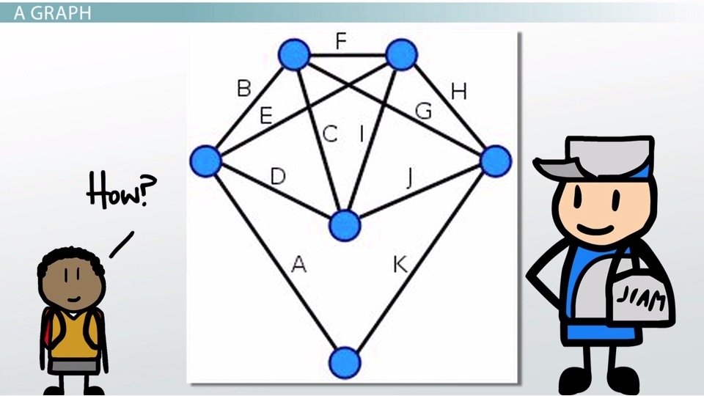
To understand Euler's Theorem, let's break it down:
Necessary Condition: If a graph has an Euler cycle, then every vertex in the graph must have an even degree. This means that the number of edges connected to each vertex must be an even number. If there is any vertex with an odd degree, it is not possible to traverse all the edges and return to the starting vertex without retracing an edge.
Sufficient Condition: If every vertex in a connected graph has an even degree, then the graph has an Euler cycle. This means that if all the vertices have an even number of edges, it is possible to find a cycle that visits every edge exactly once and returns to the starting vertex. This cycle is called an Euler cycle.
Euler's Theorem

Slide 4
The Hierholzer algorithm is a famous algorithm in graph theory used to find Eulerian paths or cycles in a graph.
It was developed by a Swiss mathematician named Carl Hierholzer.
Hierholzer's Algorithm

Slide 5
Start with a connected graph that may or may not have an Eulerian path or cycle.
Choose any vertex as the starting point and follow an arbitrary unused edge to another vertex.
Keep following unused edges until you return to the starting vertex. This forms a cycle.
4. If there are unused edges in the graph, choose a vertex in the current cycle that still has unused edges and start a new cycle from that vertex. Repeat step 3.
5. Continue this process until all edges have been used. At this point, you will have formed a collection of cycles.
6. Merge all the cycles together by following the unused edges of the cycles, as long as it doesn't create a cycle. This will result in a single Eulerian path or cycle.

Slide 6
Implementation Example

Slide 7
The Hierholzer algorithm has a time complexity of O(|E|), where |E| is the number of edges in the graph.
Complexity Analysis

Slide 8
Time Complexity:
Constructing the adjacency list representation of the graph takes O(E) time.
Finding the starting vertex for the Eulerian path or circuit takes O(V) time.
The main part of Hierholzer's algorithm is the loop that traverses each edge once. In the worst case, each edge is visited exactly once, resulting in O(E) iterations of the loop.
Within each iteration, removing an edge from the graph and updating the current vertex takes constant time.
Overall, the time complexity of Hierholzer's algorithm is O(E).
Time Complexity Analysis

Slide 9
Space Complexity:
The space complexity is determined by the adjacency list representation of the graph. In the worst case, each vertex can be connected to all other vertices, resulting in O(E) space.
Additionally, a stack is used to keep track of the current path, which can have at most E + 1 elements (each edge is pushed and popped once, and the circuit ends at the starting vertex).
Therefore, the space complexity of Hierholzer's algorithm is O(E).
Space Complexity Analysis

Slide 10
Explore real-world applications of Euler cycles:
Transportation networks
5. Sudoku puzzles
2. DNA sequencing
4. Circuit board testing
3. Computer network routing
6. Tour planning
Applications

Slide 11
Conclusion
In conclusion, we have explored the process of finding an Euler cycle in a graph. By utilizing Euler's theorem and Hierholzer's algorithm, we can determine and locate Euler cycles within a graph.
We have discussed the significance of Euler cycles and provided a specific example of applying the Hierholzer algorithm in practical scenarios.
Additionally, we have analyzed the complexity of the Hierholzer algorithm, enabling us to understand its efficiency and scalability.
Furthermore, we have explored real-world applications of Euler cycles in various domains, such as network infrastructure and optimization problems.
Finally, understanding the algorithm for finding Euler cycles and its practical applications equips us to tackle complex problem-solving.

Slide 12
Thank you !

